Slide 1



March 27 - 28
Digital streaming: who upgrades, who waits & who never will
ABA Hackathon Spring ‘26
Presented by :
Coding Rookie
Team Members: Julie, Simon, Antara, Apoorv
1

Slide 2
1
Problem statement
List of Contents
2
Dataset ETL
3
EDA Snapshot
4
Model choice & rationale
5
Feature Engineering
6
Model results
7
Limitations And Conclusion
2

Slide 3
Let’s predict when your streaming user will
choose short-term savings over long-term value..
Streaming platforms offer tiered subscriptions : ad-supported vs. premium. Every pricing, promotion, and design decision depends on understanding when users prioritize cost savings versus experience quality.
Analytics team building predictive models to support tier optimization and customer lifetime value
1M+ behavioral decisions · 11K+ participants · intertemporal choice experiments with response-time signals
Translate research-grade behavioral data into actionable, interpretable predictions that drive subscription strategy
Our Role
The Data
Our Goal
3

Slide 4
Dataset & ETL
DATASET AT A GLANCE
1M+
decision observations
----------------------------
11K+
unique participants
-------------------------------
Each record contains
— Immediate vs. delayed choice
— Response time (ms)
— Experimental context
DATA SOURCE
Multi-country study about human behavioral decisions:
where participants traded off an immediate reward against a larger delayed one
Compiled across multiple lab studies into a single large-scale dataset.
ETL PIPELINE
Raw data
Dropped non related
Outlier Handling
Clean dataset
KEY ASSUMPTION
Each observation is treated as independent — participant-level clustering effects are acknowledged but not modeled in this phase. Response time is retained as a behavioral signal, not noise.
4

Slide 5
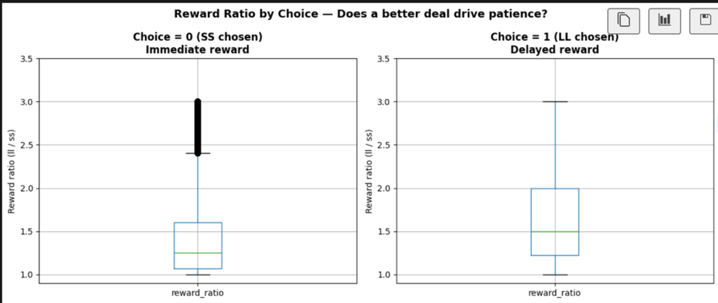
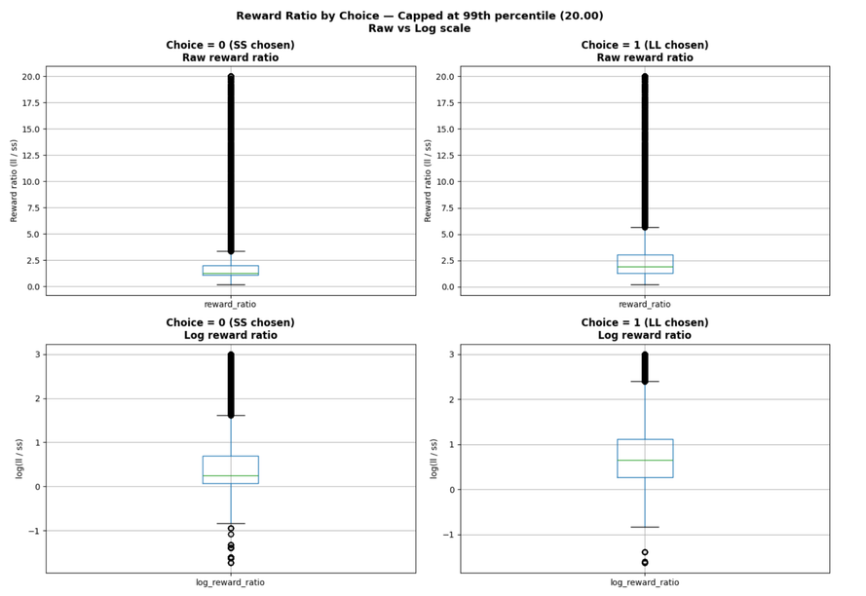
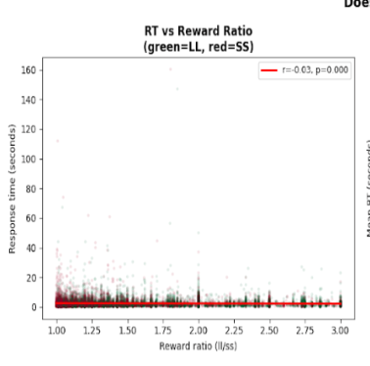
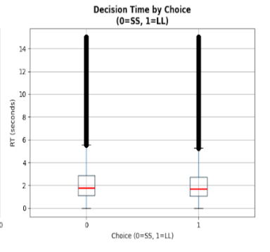
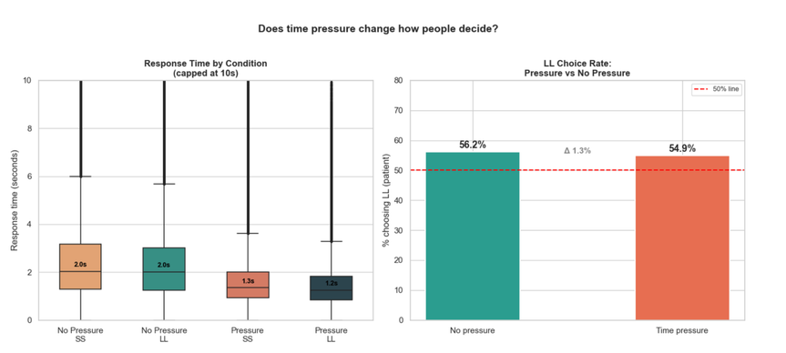
EDA Snapshot
How Reward Payoff Time Influences Choice
Reward Ratio by Choice
People choose LL when:
the bigger‑later option offers a better deal
higher reward ratios associated with more patient choices.
The sooner option is almost always available immediately, while the later option requires waiting from weeks to years — highlighting the stark difference in delay between the two choices.
Response Time vs. Reward Ratio
Effect of Time Pressure on Choice
Time pressure makes people decide much faster
but it barely changes what they choose
response times drop sharply under pressure, while LL choice rates remain almost identical.
Response time barely changes as the reward ratio increases — people don’t take longer to decide even when the larger‑later option becomes a much better deal.
5

Slide 6
3 model , 1 target
Target variable: did the user choose the immediate reward? (binary 0/1). Each model was chosen to answer a different question about the same prediction problem.
LOGISTIC REGRESSION
RANDOM FOREST
XGBOOST
Logistic Regression draws a straight mathematical line to separate two groups (patient vs. impatient)
Expect to find that patience_rate strongly pushes people toward LL (patient) while log_discount_k strongly pushes toward SS (impatient)
Predict whether a person will choose the patient option or the impatient option Binary 0 or 1
Train: 80% test: 20%
Feature interactions that logistic regression misses
e.g. how response time and reward magnitude interact to influence choice behavior.
14 features (raw and engineered)
Gradient boosting on a 1M+ row dataset optimized for predictive accuracy.
Candidate for production-level scoring of user behavior at scale.
STRENGTH: INTERPRETABILITY
STRENGTH: NON LINEARITY + ROBUSNESS
STRENGTH: BEST PREDICTIVE ACCURACY
6

Slide 7
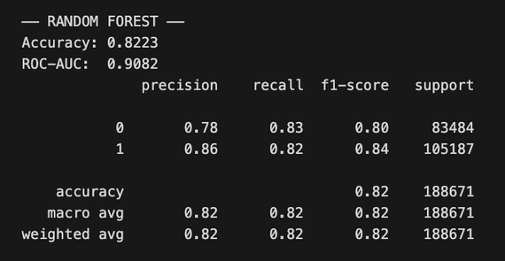
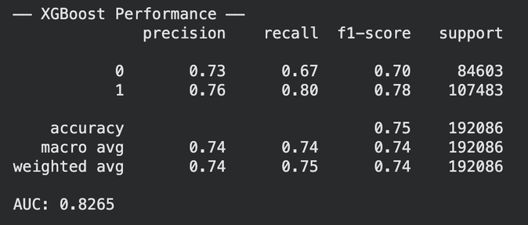
Result: 3 model , 1 target
Target variable: did the user choose the immediate reward? (binary 0/1). Each model was chosen to answer a different question about the same prediction problem.
LOGISTIC REGRESSION
RANDOM FOREST
XGBOOST
Found patience_rate strongly pushes people toward LL (patient) while log_discount_k strongly pushes toward SS (impatient)
Confirmed by their coefficients (+1.34 and −1.07 respectively)
~76% accuracy, slightly weaker than Random Forest because real human behavior isn't perfectly linear.
key drivers:
patience_rate (~0.45) historical customer RT.
log_discount_k (~0.21) — how steeply someone discounts future rewards.
SHAP confirms the same story who the person is (patience_rate) matters far more than what the offer is.
Key drivers:
delay_diff (0.066)
value_ratio (0.065)
fixed_all_value (0.047) — When the premium value is anchored and visible, it paradoxically pushes customers away
Model confirms that customer decisions are non-linear and complex.
STRENGTH: BEST PREDICTIVE ACCURACY
7

Slide 8
Feature Engineering
VALUE DIFFERENCE (LL-SS)
Measures how much more valuable the delayed reward is compared to the immediate one
A direct signal of the premium offer’s added benefit
TIME DIFFERENCE IN DAYS (LL DELAY-SS DELAY)
Captures how much longer the delayed reward requires you to wait compared to the immediate option
Represents the psychological ‘cost of waiting,’ a key factor influencing whether users stick with the cheaper tier or consider upgrading
REWARD RATIO ( LL VALUE / SS VALUE)
Measures how attractive the delayed reward is relative to the immediate one
Helps the model capture whether users respond more to relative value than absolute differences, which is often a stronger driver of upgrade behavior
AGE GROUP
Age was binned into 12 granular brackets to avoid masking nonlinear behavioral patterns
This lets the model capture sharp shifts in impatience or upgrade likelihood that a single continuous age variable would smooth out
8

Slide 9
When..
We should target..
How..
Impulsive user
Undecided users
Patient users
High k · Fast RT • Chose SS
Medium k · Slow RT • Chose SS
Low k · Fast RT • Chose LL
→ Unlikely to self-upgrade — price-sensitive, short time horizon
→Strategy: time-limited flash offers ("upgrade today, 50% off")
→Focus on ad-tier monetization, not conversion spend
→ Slow RT signals genuine deliberation — they're actually considering it
→ Strategy: free trial nudge, social proof, feature comparison
→Highest ROI for personalized engagement spend
→ ~20% of users — naturally long time horizon, high CLV potential
→ Strategy: annual plan messaging, loyalty benefits, value-stacking
→Respond to long-term value framing, not discounts
9
Remark: discount rate k(k = (LL/SS - 1) / delay) k is the hyperbolic discount rate it measures how impatient someone is when choosing between a reward now vs. later.

Slide 10
However , limitations..
Tipping ratio may not generalize
Task design drives large behavioral differences
The 1.29× threshold (LL adoption >50%) is derived from this dataset; real‑world customers may respond differently to value ratios.
Procedure type explains ~30pp variation in LL choices, meaning model predictions are partly shaped by experimental structure rather than pure user traits
Online vs. lab differences complicate interpretation
Age effects are nonlinear and hard to generalize
Online participants show ~8pp more impatience, so results depend on testing environment and may shift in real product contexts
Older users are slower and more variable in RT, but not uniformly less patient — demographic effects are not straightforward
Feature importance reflects task structure
Thresholds and effects vary across subgroups
MI ranking shows reward amounts and delays dominate; context variables matter for interpretation but contribute less predictive power
The tipping ratio, impatience gap, and age‑related patterns are not uniform across all demographic or contextual segments, meaning some findings may only hold for specific groups rather than the full population
10

Slide 11

Recommendations
1. Pricing subscription tiers with
upfront value clarity for patient customers (annual plans, discounts)
flex lower-barrier entry for impatient customers (free trials, weekly passes).
One-size-fits-all approach won't work!
CUSTOMER SEGMENTATION
Patient Customers
→ Long-term value maximizers
Respond to: loyalty programs, exclusive perks, tiered rewards, content library depth
Strategy: High lifetime value (LTV) focus
Impatient Customers
→ Immediate gratification seekers
Respond to: instant discounts, new content drops, quick wins/achievements
Strategy: Short-term engagement + conversion to loyalty
2. Lifetime Value Management: Use predictive models to identify which segment each customer belongs to based on behavioral signals (churn indicators, engagement patterns)
allocate retention budget accordingly.
3. Engagement Strategy:
dual reward systems loyalty points and exclusive content for patient ones
gamification, instant notifications, and limited-time offers for impatient ones.
11

Slide 12

Thank You
Questions?
12

